Slide 1

R from Scratch An Intro to Data Analytics

Slide 2
Agenda
Introduction
Learning Objectives
Important Questions
Setting Up Your Environment
The burden of the programmer
Few last words
Exercise: Getting Comfortable with R and RStudio
Notes:
Agenda * Introduction * Learning Objectives * Important Questions * What is a programming language? * What is the R language? * Why R and not Python? * What is data analytics? * What are the tools of the trade? * Why it matters? * I am sold. Where to Start? * Setting Up Your Environment * Installing R * Installing RStudio * Getting to Know the RStudio Interface * Installing Packages * Writing Your First R Script * The burden of the programmer * Few last words * Exercise: Getting Comfortable with R and RStudio * Exercise 1: Explore RStudio * Exercise 2: Install and Load a Package * Exercise 3: Use the Help Tab * Exercise 4: Experiment in the Console

Slide 3
Introduction
Comprehensive guide to mastering R programming language
Smooth learning curve and deep understanding of fundamentals
R is designed for statistical computing and graphics
Widely used for statistical software development and data analysis
Open-source project with a vibrant community
Rich ecosystem of packages and resources
First half of book covers programming concepts
Gradually builds up to more complex topics
Second half explores data analysis
Covers data cleaning, advanced manipulation, and statistical analysis
Notes:
Welcome to R from Scratch, your guide to mastering the R programming language. This book is designed to guide beginners through the world of R programming, providing a smooth learning curve and deep understanding of the fundamentals. R is an open-source language designed for statistical computing and graphics, with a rich ecosystem of packages and resources. The first half of the book covers programming concepts, while the second half explores data analysis. Our goal is to empower you to use R confidently and effectively.

Slide 4
Learning Objectives
Understand the Advantages of R for Data Analysis
Recognize why R is a preferred tool for data analysis and statistical modeling
Learn about its ecosystem of packages and compatibility with report-generation tools for reproducible research
Define Data Analytics and its Importance
Describe the role of a data analyst and the significance of data analytics in uncovering insights from large datasets
Learn how data analytics informs decision-making in various sectors
Identify Essential Tools for Data Analysis
Become familiar with the RStudio Integrated Development Environment (IDE)
Appreciate the Impact of Data Analytics
Set Up the R Programming Environment
Install R and RStudio
Navigate the RStudio Interface
Notes:
In this chapter, we will learn about the advantages of using R for data analysis, the importance of data analytics, essential tools for data analysis, the impact of data analytics, how to set up the R programming environment, and how to navigate the RStudio interface.

Slide 5
What is a programming language?
Programming languages are used to communicate with machines
Structured set of syntax and semantics
Allows humans to express instructions for computers to execute
There are many different programming languages
Each with distinct characteristics and functionalities
Some are tailored for specific tasks, while others are general-purpose
This book focuses on the R language for data analysis
Covers basics of data manipulation to advanced statistical techniques
Includes best practices for data cleaning and preprocessing
Provides hands-on experience with real-world datasets
Notes:
In this slide, we introduce the concept of programming languages, which are used to communicate with machines. There are many different languages, each with their own characteristics and uses. This book focuses on the R language, which is used for data analysis. We will cover everything from the basics to advanced techniques, and provide hands-on experience with real-world datasets.

Slide 6
What is the R language?
Programming language for statistical analysis and data visualization
Widely used by statisticians, data scientists, and researchers
Provides a wide variety of statistical and graphical techniques
Linear and nonlinear modeling, classical statistical tests, time-series analysis, classification, clustering, and others
Highly extensible and supports multiple programming paradigms
Object-oriented, imperative, and functional programming
Notes:
R language is a programming language made for statistical analysis and data visualization. It is widely used by statisticians, data scientists, and researchers. R provides a wide variety of statistical and graphical techniques and is highly extensible, supporting multiple programming paradigms.

Slide 7
Why R and not Python?
Python is a versatile and general-purpose language
Applicable to a wide range of tasks
R is developed by statisticians and excels in handling complex statistical operations
Offers an extensive array of statistical tests and models
R provides a unique and advanced experience for data visualization
Libraries such as ggplot2 and shiny enable the creation of sophisticated and flexible plots
R's syntax is designed to be intuitive and user-friendly for data analysis and statistical work
Rich ecosystem of packages tailored for data analysis
R's compatibility with report-generation tools positions it as an excellent resource for reproducible research
Users can integrate code, outputs, and narrative into a cohesive document
Notes:
In this slide, we discuss the question of whether to learn R or Python for data analysis. While Python is a versatile and general-purpose language, R, developed by statisticians, excels in handling complex statistical operations and provides a unique and advanced experience for data visualization. R's syntax is designed to be intuitive and user-friendly for data analysis and statistical work, and its compatibility with report-generation tools positions it as an excellent resource for reproducible research.

Slide 8

Important Questions: What is data analytics?
Explore vast amounts of data to provide insights
Answer specific questions, from fun to serious
Uncover patterns, trends, and insights
Use tools to uncover hidden information
Notes:
As a data analyst, you'll explore vast amounts of data to provide insights and answer specific questions. Using tools, you'll uncover patterns, trends, and insights that are not immediately obvious. Your job is to investigate and find answers. Original Content: Your main task as a data analyst is to explore vast amount of data and provide insights from this data. Think of yourself as an investigator whose job is to find answers to specific questions. These questions could be anything from fun to serious, who is the most popular manga character? What are the average home runs per season in the MLB? What year had the most category 5 hurricanes? etc. Data analytics is the process of examining these massive collections of data to uncover patterns, trends, and insights that are not immediately obvious. Nevertheless, to uncover these patterns and insights you need tools.

Slide 9
Important Questions: What are the tools of the trade?
RStudio is an IDE for R programming
Provides a user-friendly interface and tools to enhance coding experience
Streamlines the process of writing, debugging, and executing R code
Offers features such as syntax highlighting, code completion, and integrated documentation
Provides tools for managing and visualizing data
Allows for creation of interactive visualizations and generation of reports
A versatile tool for efficient and effective R programming
Notes:
RStudio is an IDE that makes it easier to write and run R code. It offers features such as syntax highlighting, code completion, and integrated documentation. RStudio also provides tools for managing and visualizing data, creating interactive visualizations, and generating reports. It is a powerful and versatile tool for R programming. Original Content: We talked above about R as a good programming language for data analysis, but what are the tools that you need to use R effectively? The most crucial tool is the RStudio IDE. RStudio is an IDE that makes it easier to write and run R code. It provides a user-friendly interface and a plethora of tools to enhance your coding experience and productivity. RStudio is designed to streamline the process of writing, debugging, and executing R code. It offers features such as syntax highlighting, code completion, and integrated documentation, making it easier to write and understand R code. RStudio also provides tools for managing and visualizing data, creating interactive visualizations, and generating reports. It is a powerful and versatile tool that will help you become a more efficient and effective R programmer.

Slide 10
Important Questions: Why it matters?
Data Analytics for Informed Decisions
Enables organizations to identify opportunities and solve complex problems
Used in a wide range of industries, including finance, healthcare, marketing, and technology
Skills Required for Data Analysts
Proficiency in programming languages like R and Python
Familiarity with tools like RStudio and Jupyter Notebook
Knowledge of statistical techniques, data visualization, and machine learning
Notes:
Data analytics is a critical component of modern business and research. It enables organizations to make informed decisions, identify opportunities, and solve complex problems. As a data analyst, you will need to be proficient in programming languages like R and Python, as well as tools like RStudio and Jupyter Notebook. You will also need to be familiar with statistical techniques, data visualization, and machine learning. Original Content: Data analytics is a critical component of modern business and research. It enables organizations to make informed decisions, identify opportunities, and solve complex problems. Data analytics is used in a wide range of industries, including finance, healthcare, marketing, and technology. It is also used in scientific research to analyze experimental data and make new discoveries. By learning R and data analytics, you will be equipped with the skills to contribute to these fields and make a meaningful impact. As a data analyst in the real world, you will be responsible for collecting, cleaning, and analyzing data to extract valuable insights. You will need to be proficient in programming languages like R and Python, as well as tools like RStudio and Jupyter Notebook. You will also need to be familiar with statistical techniques, data visualization, and machine learning. By mastering these skills, you will be able to tackle complex data analysis tasks and provide valuable insights to your organization or research team.

Slide 11
I am sold. Where to Start?
Setting Up Your Environment
Install R and RStudio for a user-friendly coding experience
Familiarize Yourself with the Basics
Understand the structure of R scripts and how to execute code
Practice, Practice, Practice
Make use of exercises and examples to improve your skills
Make Use of Resources
Supplement your learning with online tutorials, forums, books, and courses
Learn by Doing
Apply your knowledge to real-world data for invaluable experience
Take It One Step at a Time
Don't rush through the topics and celebrate your progress
Notes:
Embark on the journey of learning R with these initial steps and resources. Set up your environment with R and RStudio, familiarize yourself with the basics, and practice regularly. Make use of resources and learn by doing with real-world data. Take it one step at a time and celebrate your progress. Original Content: Embarking on the journey of learning a new programming language, especially when it’s your first, can be a daunting task. If you are wondering where to start or what you need to get going. In this subsection, we’ll outline the initial steps and resources that will set you up for success in mastering R. 1. Setting Up Your Environment. Before diving into the language, it is crucial to set up a proper working environment. The first chapter of this book will guide you through the process of installing R and RStudio, a popular IDE that makes it easier to write and run R code. RStudio provides a user-friendly interface and a plethora of tools to enhance your coding experience and productivity. 2. Familiarize Yourself with the Basics. Once your environment is ready, start by familiarizing yourself with the basic syntax and conventions of R. Don’t worry about memorizing every function or command at this stage. Focus on understanding the structure of R scripts, how to execute code, and how to interpret the results. 3. Practice, Practice, Practice. Programming, like any other skill, requires practice. Make use of the exercises and examples provided throughout this book to practice writing R code. Try to modify the examples and see how the results change. If you’re feeling adventurous, try to solve small problems on your own using what you’ve learned. 4. Make Use of Resources. There is a vast array of resources available for learning R, ranging from online tutorials and forums to books and courses. This book will be your primary guide, but don’t hesitate to seek out additional resources to supplement your learning. The R community is known for its inclusivity and willingness to help newcomers, so take advantage of forums like Stack Overflow and the RStudio Community to ask questions and learn from others. 5. Learn by Doing. R is particularly strong in data manipulation, statistical analysis, and graphical representation of data. As you progress through the book, try to apply what you’ve learned to real-world data. There are numerous public datasets available for practice, and working with real data will provide invaluable experience. 6. Take It One Step at a Time. Learning to program is a marathon, not a sprint. Don’t rush through the topics; take the time to understand each concept before moving on to the next. It’s normal to feel challenged but remember that persistence is key. Celebrate your progress, no matter how small, and don’t get discouraged by setbacks.

Slide 12
Setting Up Your Environment: Installing R
Windows
Visit the CRAN website and choose a geographically close mirror
Click on 'Download R for Windows' then 'base'
Download and run the latest version of R, following the instructions
Mac
Visit the CRAN website and choose a geographically close mirror
Click on 'Download R for (Mac) OS X'
Download and open the latest version of R, following the instructions
Linux
Installation process depends on distribution
Visit the CRAN website and navigate to the section for your distribution
Notes:
R is available for Windows, Mac, and Linux. You can download it from the Comprehensive R Archive Network (CRAN). The installation process is different for each operating system. For Windows and Mac, visit the CRAN website, choose a geographically close mirror, and follow the instructions. For Linux, the installation process depends on your distribution. Visit the CRAN website for detailed instructions.

Slide 13
Setting Up Your Environment: Installing RStudio
Integrated Environment
Provides an all-in-one interface for writing scripts, viewing output, visualizing data, and managing packages
User-Friendly Interface
Clean and well-organized layout makes it easier for beginners to find and use the features they need
Helpful Tools and Shortcuts
Includes a variety of tools and shortcuts that simplify coding in R
Extensive Community and Resources
Large and active community with a wealth of tutorials, forums, and resources available
Designed Specifically for R
Tools and features are tailored to the needs of R users
Notes:
RStudio is an excellent choice for those new to R. It provides an integrated environment, user-friendly interface, helpful tools and shortcuts, extensive community and resources, and is designed specifically for R. These features make it the recommended interface for working through the examples and exercises in this book. Original Content: While R provides a comprehensive programming environment, RStudio enhances this environment by offering a more user-friendly and intuitive interface, which is especially helpful for those new to programming. RStudio consolidates various R functions and tools into one easy-to-navigate workspace, facilitating a smoother learning curve and increased productivity. In this book, we have chosen RStudio as our primary interface for learning R for several reasons: 1. Integrated Environment: RStudio provides an all-in-one interface for writing scripts, viewing output, visualizing data, and managing packages. This integration helps streamline the learning process and keeps everything you need accessible in one place. 2. User-Friendly Interface: The clean and well-organized layout of RStudio makes it easier for beginners to find and use the features they need. This is crucial when you are starting out, as it reduces the overhead of learning how to navigate the programming environment in addition to learning the language itself. 3. Helpful Tools and Shortcuts: RStudio includes a variety of tools and shortcuts that simplify coding in R. Features like auto-completion, syntax highlighting, and the ability to easily run portions of your script, all contribute to a more productive and enjoyable coding experience. 4. Extensive Community and Resources: RStudio has a large and active community, which means there is a wealth of tutorials, forums, and resources available to help you learn and troubleshoot issues. 5. Designed Specifically for R: Unlike some other IDEs that support multiple programming languages, RStudio is designed specifically for R. This specialization ensures that the tools and features provided are tailored to the needs of R users. For these reasons, RStudio is an excellent choice for those new to R, and it is the recommended interface for working through the examples and exercises in this book. By providing a supportive and efficient learning environment, RStudio allows you to focus on mastering the R language itself, setting the stage for a successful and enjoyable learning experience.

Slide 14
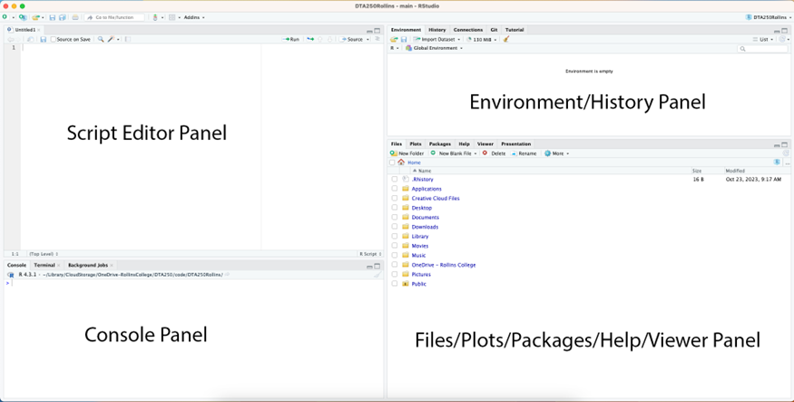
Setting Up Your Environment: Getting to Know the RStudio Interface
Script Panel
Top left panel for writing and editing R scripts
Console Panel
Bottom left panel where R code is executed and results are displayed
Environment/History Panel
Top right panel displaying datasets, variables, and command history
Files/Plots/Packages/Help/Viewer Panel
Bottom right panel for managing files, viewing plots, and accessing help
Additional Features
Autocomplete, syntax highlighting, debugging tools, and version control integration
Notes:
In this section, we'll be discussing the RStudio interface, which is divided into four main panels. The Script panel, Console panel, Environment/History panel, and the Files/Plots/Packages/Help/Viewer panel. Additionally, RStudio offers features such as autocomplete, syntax highlighting, debugging tools, and version control integration to enhance your coding experience. Original Content: 1.3.3 Getting to Know the RStudio Interface The RStudio interface shown divided into four main panels with the label for each panel added on top by the author so that they can be easily distinguished. The left top panel is the Script panel, in the bottom left panel is the Console panel, in the top right is the Environment/History panel, and in the bottom right is the Files/Plots/Packages/Help/Viewer panel. Source: Jasser Jasser The RStudio interface is designed to make your R programming experience as smooth and efficient as possible. When you first open RStudio, you’ll see a layout divided into three main panels, with a potential fourth panel appearing when you open or create scripts. Let’s take a closer look at each of these areas to understand their functions and how they can aid your programming journey. 1.3.3.1 Console Panel • Description: The Console is where R code is executed line by line. It is also where the results or outputs of your code are displayed. When you start RStudio, it opens an R session in the Console, indicated by the > prompt. • Usage: You can type R commands directly into the Console and press Enter to run them. For longer sets of commands, or for creating reusable code, it’s more practical to write them in a script. 1.3.3.2 Script Editor Panel • Description: The Script Editor is a text editor designed for writing and editing R scripts. Scripts are files containing a series of R commands that can be saved and re-executed later. • Usage: To create a new script, go to File > New File > R Script. You can run commands from the script editor by highlighting them and pressing Ctrl + Enter (Windows/Linux) or Cmd + Enter (Mac). Running commands from a script ensures reproducibility and ease of editing. 1.3.3.3 Environment/History Panel • Environment Tab: – Description: This tab displays the datasets and variables that you have created in your current R session. It provides a snapshot of your current working environment, including the size and type of your data objects. – Usage: You can click on the names of datasets to view them and use the options in the Environment tab to import datasets, clear the workspace, or perform other management tasks. • History Tab: – Description: The History tab keeps track of all the commands you’ve run in the R console, allowing you to easily see and revisit previous work. – Usage: You can select commands from the History and run them again or copy them into a script for modification and reuse. 1.3.3.4 Files/Plots/Packages/Help/Viewer Panel • Files Tab: Navigate through your computer’s file system and manage files within RStudio. • Plots Tab: View visualizations and plots generated by your R code. You can also export plots from this tab. • Packages Tab: Manage R packages, including installing, updating, and loading packages. • Help Tab: Access R’s built-in help and documentation. You can search for help on specific functions or topics. – You can use the ? operator to access help for a specific function. For example, if you type ?mean in the console, it will open the help page for the mean function. • Viewer Tab: View web content, including R Markdown documents and Shiny apps, within RStudio. 1.3.3.5 Additional Features • Autocomplete: RStudio provides suggestions as you type, helping to minimize errors and making it easier to remember function names and arguments. • Syntax Highlighting: Different elements of R code (such as functions, variables, and operators) are displayed in distinct colors, making it easier to read and understand your code. • Debugging Tools: RStudio includes tools for debugging R code, helping you identify and fix errors more quickly. • Version Control Integration: RStudio supports integration with version control systems like Git, facilitating code management and collaboration. Familiarizing yourself with these features and tools in RStudio will greatly enhance your coding experience, making it easier to write, run, and debug your R scripts. As you work through the examples and exercises in this book, take the time to explore and experiment with these various features to fully leverage the capabilities of RStudio.

Slide 15
Setting Up Your Environment: Installing Packages
Open-source programming language
Users can contribute and share code
Contributions often come in the form of packages
Tidyverse package
Collection of R packages designed for data science
Includes packages for data manipulation, visualization, and import
Installing and loading tidyverse
Use install.packages() and library() functions
Managing packages
Update packages with update.packages() function
View installed packages with installed.packages() function
Load multiple packages at once with library() function
Notes:
R is an open-source programming language where users can contribute and share code in the form of packages. The tidyverse package is a collection of R packages designed for data science. It can be installed and loaded using the install.packages() and library() functions. Packages can be managed by updating, viewing installed packages, and loading multiple packages at once. Original Content: R is an open-source programming language, which means that users can contribute and share their code and tools with the rest of the community. These contributions often come in the form of packages, which are collections of functions, data, and compiled code that extend the functionality of R. They are a vital part of the R ecosystem, providing tools for a wide variety of tasks and applications. 1.3.4.2 Installing the tidyverse Package. In this book, we will make extensive use of the tidyverse, a collection of R packages designed for data science. The tidyverse includes packages for data manipulation (e.g., dplyr, tidyr), data visualization (e.g., ggplot2), and data import (e.g., readr). Installing and loading the tidyverse package gives you access to a suite of tools that work seamlessly together for data analysis. 1. Installing the Package: To install the tidyverse, run the following command in the R Console: install.packages("tidyverse") This command tells R to download the tidyverse package from CRAN and install it on your computer. Depending on your internet connection and computer speed, this process may take a few minutes. 2. Loading the Package: Once the package is installed, you need to load it into your R session to use it. To load the tidyverse, run: library(tidyverse) When you load the tidyverse, you might see messages in the console indicating which packages are being attached. This is normal and shows that the tidyverse is being loaded properly. 1.3.4.3 Managing Packages • Updating Packages: Over time, the packages you have installed may be updated by their authors to include new functions, fix bugs, or improve performance. To update your packages, you can use the update.packages() function. update.packages() • Viewing Installed Packages: To see a list of all the packages you have installed, you can use the installed.packages() function. This function returns a table with information about each package. • Loading Multiple Packages: You can load multiple packages at once using the library() function and separating the package names with a comma. However, since the tidyverse package automatically loads multiple core packages, you often just need to load tidyverse itself.

Slide 16
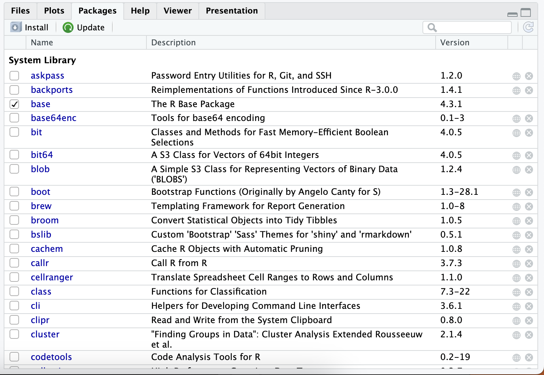
Setting Up Your Environment: Installing Packages
Manage R packages installed on your device
Install, remove, or update packages
Check box next to each package
Indicates if package is loaded into environment
User-friendly interface
View, load, update, and uninstall packages
Notes:
The Packages tab in RStudio allows you to manage the R packages installed on your device. You can install, remove, or update packages, and a check box next to each package indicates if it is loaded into your environment. The interface is user-friendly, allowing you to view, load, update, and uninstall packages with ease. Original Content: 1.3.4.4 Packages Tab in RStudio The package tab shows all the R packages installed on your device. You can manage these packages from this tab, either installing, removing, or updating. Next to each package is a check box. If the check box is checked, then the package is loaded into your environment. We will discuss what that means in later chapters. Source: Jasser Jasser The Packages tab in RStudio is a dedicated space for managing the R packages that you have installed on your computer. It provides a user-friendly interface for viewing, loading, updating, and uninstalling packages. Here’s a more detailed overview:

Slide 17
Setting Up Your Environment: Installing Packages
Viewing Installed Packages
Access the Packages tab in the lower right panel of RStudio
Displays a list of all the R packages that are currently installed on your system
Check or uncheck the box next to a package name to load or unload it
Loading Packages
Check the box next to the package name or type library(packagename) in the console or script editor
Installing New Packages
Click the “Install” button in the Packages tab or use the install.packages("packagename") function
RStudio will also install any dependencies
Updating Packages
Uninstalling Packages
Viewing Package Documentation
Notes:
In RStudio, you can manage your packages through the Packages tab. Here, you can view, load, install, update, uninstall, and access the documentation for your packages. Simply navigate to the Packages tab and use the provided buttons and checkboxes to perform the desired actions. Original Content: 1.3.4.4.1 Viewing Installed Packages • How to Access: You can find the Packages tab in the lower right panel of RStudio, alongside tabs like Files, Plots, and Help. • Functionality: The Packages tab displays a list of all the R packages that are currently installed on your system. • Usage: Each package in the list has a checkbox next to its name. Checking this box loads the package into the current R session, while unchecking the box unloads the package. 1.3.4.4.2 Loading Packages • How to Load a Package: To load a package, simply find it in the list and check the box next to its name. Alternatively, you can load a package by typing library(packagename) in the console or script editor, replacing “packagename” with the name of the package you wish to load. 1.3.4.4.3 Installing New Packages • How to Install: While you can install packages directly from the console using the install.packages("packagename") function, you can also install packages through the Packages tab by clicking the “Install” button. This opens a dialog box where you can type in the name of the package you want to install and choose from which repository to install it. • Dependencies: When installing a package, RStudio will also install any other packages that the chosen package depends on (its dependencies). 1.3.4.4.4 Updating Packages • How to Update: The Packages tab also provides an effortless way to update your installed packages. If an update is available for any of your installed packages, a small arrow will appear next to the package’s name in the Packages tab. Clicking this arrow will update the package. • Update All: You can also update all your packages at once by clicking the “Update” button in the Packages tab. This opens a dialog box that lists all packages with available updates, and you can choose which ones to update. 1.3.4.4.5 Uninstalling Packages • How to Uninstall: To remove a package that you no longer need, you can click on the package in the list to select it, and then click the “Remove” button. 1.3.4.4.6 Viewing Package Documentation • Accessing Documentation: To view the documentation for a package, click on the package name in the list. This will open the Help tab and display a list of all the functions available in that package, along with other documentation that comes with the package.

Slide 18
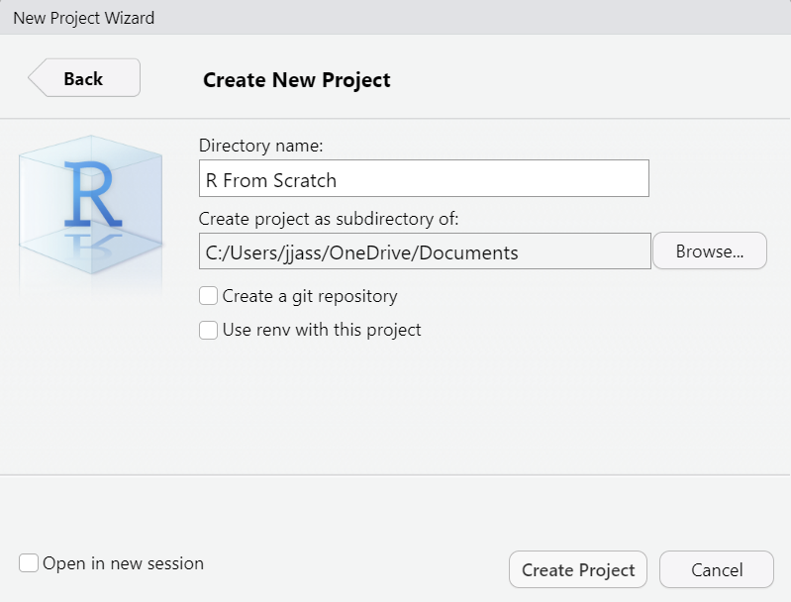
Setting Up Your Environment: Writing Your First R Script
Step 1: Create a new project
Go to File > New Project in RStudio
Select 'New Directory' then 'New Project'
Enter project name and directory location
Step 2: Open a New Script
Go to File > New File > R Script in RStudio
A new tab will open in the script editor
Step 3: Type Your Commands
Enter R commands in the script editor
Step 4: Save Your Script
Step 5: Run Your Script
Step 6: Review and Experiment
Notes:
In this section, we will guide you through writing your first R script. We will cover creating a new project, opening a new script, typing commands, saving your script, running your script, and reviewing and experimenting with the output. Follow these steps to get started with R programming. Original Content: Getting firsthand experience is crucial when learning a new programming language. In this section, we will guide you through writing your first R script, a simple exercise that introduces you to the basics of R syntax, the script editor, and the console in RStudio. However, we first need to create a new project that will include all the scripts created during your learning journey. 1.3.5.1 Step 1: Create a new project. • How to Create: In RStudio, go to File > New Project. This will open a dialog box where you can choose the type of project you want to create. For now, select “New Directory” and then “New Project”. Enter the name of your project and specify the directory location of this project. This will create a new folder on your computer and set it as the working directory for your R session. This graph shows the new project wizard which the user will use to define the name of their project and the directory location where their project will be stored on their machine. Source: Jasser Jasser 1.3.5.2 Step 2: Open a New Script • How to Open: In RStudio, go to the top menu and select File > New File > R Script. This will open a new tab in the top-left panel, which is your script editor. • What is a Script? A script in R is a text file that contains a series of commands. These commands can be run line by line or all at once, and they can be saved for future use. 1.3.5.3 Step 3: Type Your Commands • Entering Code: In the script editor, type the following R commands: # This is my first R script print("Hello, R!") This image shows the Script Panel. Once you create a new R script, a new tab for your script will appear in this panel. The script is empty. In this image, the author creates a comment followed by a print() statement to demonstrate the process of creating a new script and writing code into the script. Source: Jasser Jasser • Understanding the Syntax: – Comments: In R, anything after a # symbol is considered a comment. Comments are not executed as code, but they are useful for leaving notes and explanations in your script. In the example above, # This is my first R script is a comment. – print() Function: The print() function is used to display the result of a computation or the content of a variable. In this case, it is used to print the text “Hello, R!” to the console. 1.3.5.4 Step 3: Save Your Script • How to Save: To save your script, click on the floppy disk icon in the toolbar, or go to File > Save. Choose a location on your computer, enter a name for your script (e.g., “first_script.R”), and click Save. • Importance of Saving: Saving your script is important because it allows you to retain your work, even if you close RStudio. You can reopen the script at any time and continue working from where you left off. 1.3.5.5 Step 4: Run Your Script • How to Run: To run the commands in your script, place your cursor on the line of code you want to run and press Ctrl + Enter (Windows/Linux) or Cmd + Enter (Mac). You can also highlight multiple lines of code to run them all at once. • Viewing the Output: After running the commands, look at the Console panel. You should see the text “Hello, R!” printed there, indicating that your script ran successfully. This image shows the Console panel with the output of the script written in the previous step. The output shown is the sentence “Hello, R!” Source: Jasser Jasser 1.3.5.6 Step 5: Review and Experiment • Understanding the Output: Take a moment to review the output in the Console panel. Make sure it matches your expectations. • Modify and Re-run: Go back to your script and try modifying the text inside the print() function. For example, change it to print("R is fun!"). Save your script, then run the command again to see the updated output in the Console.

Slide 19
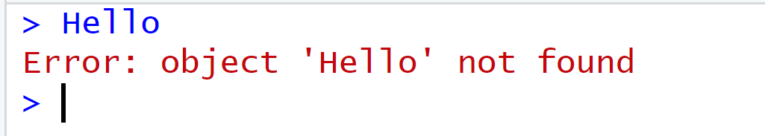
The burden of the programmer
Be careful with syntax
Use specific vocabulary understood by R Console
Errors can help trace and fix code
Example: Error message when using 'Hello' keyword
Communicating with R Console is like communicating with a cat
Both have limited vocabulary capacity
Specific phrases trigger specific reactions
Notes:
In order to communicate with the R Console, you need to use a specific vocabulary that it understands. Errors can help you trace and fix your code. It's like communicating with a cat, both have limited vocabulary capacity and specific phrases trigger specific reactions. Original Content: As you have noticed above, some of the syntax you used in the Console, or the script is weird. I wouldn’t be surprised if install.packages("tidyverse") didn’t sound as such. You must understand that you are literally talking to an unintelligent machine with limited vocabulary. Therefore, you need to be careful what you type in the R Console when you want to get a response back. As an example, if you want to be nice and say “Hello” to the Console, it will reply with the message “Error: object ‘Hello’ not found.” Not nice at all but at the same time, “Hello” as a keyword is not in the vocabulary of the R language and that is why the R Console didn’t understand it. At the same time, this error message would give you an idea what is wrong with your code so you can trace it back and fix it. In this case, you need to define what “Hello” means and then R will understand it. In this image, an error is displayed to the user by the R language indicating that the language didn’t recognize the word “Hello” as a keyword that the language understands. Source: Jasser Jasser Let me explain this to you in a much fun story. Cara is my cat, and she is a creative genius when it comes to destroying my house. However, as any other cat on this planet, she does not have a vocabulary capacity like humans do. She can understand certain words and phrases, but the extent of her vocabulary is limited. Nevertheless, Cara developed an understanding of the sentence “Come on” so that whenever I call her name and utter this sentence, she rushes to the kitchen and wait for me to give what is most precious to her, wet food. It doesn’t make sense as to why the sentence “Come on” is the key to enact such a reaction from Cara, I don’t have an answer to that, but I know for certain that whenever I want to give Cara her portion of wet food, this is the sentence I use. Like communicating with Cara, you also need to use a specific vocabulary to get an output from the R Console. Unlike communicating with Cara, the vocabulary used to converse with R make sense once you understand the logic behind it.

Slide 20

Few last words
First R script successfully written and run
Ready to dive into the world of R programming
Next chapters introduce basics of R
Plenty of opportunities for practice
Happy coding!
Notes:
Congratulations on writing and running your first R script! You're now ready to dive into the world of R programming. The next chapters will introduce you to the basics and provide plenty of opportunities for practice. Happy coding! Original Content: Congratulations! You’ve just written and run your first R script. You’re now ready to dive into the world of R programming. The next chapters will introduce you to the basics of R and provide plenty of opportunities for practice. Happy coding!

Slide 21
Exercise 1: Explore RStudio
Identify RStudio Panels
Console, Script Editor, Environment, and Files/Plots/Packages/Help
Customize Appearance
Go to Tools > Global Options > Appearance
Choose a different editor theme and click Apply
Notes:
In this tutorial, we will learn how to get started with RStudio. First, we will identify the different panels in RStudio, including the Console, Script Editor, Environment, and Files/Plots/Packages/Help. Next, we will customize the appearance of RStudio by going to Tools, then Global Options, and selecting Appearance. Here, we can choose a different editor theme and click Apply to see the changes. Original Content: 1. Open RStudio and identify the following panels: Console, Script Editor, Environment, and Files/Plots/Packages/Help. 2. Customize the Appearance: Go to Tools > Global Options > Appearance and choose a different editor theme. Click Apply and observe how the appearance of your script and console change.

Slide 22
Exercise 2: Install and Load a Package
Installation of ggplot2 Package
Install separately using console or Packages tab
Loading ggplot2 Package
Use library() function to load after installation
Exploring Packages Tab
Locate ggplot2 in list and experiment with checking/unchecking box
Observe how checking/unchecking loads/unloads package
Notes:
This slide covers the usage of the ggplot2 package in R. First, install the package separately using the console or the Packages tab. Then, load the package using the library() function. Finally, explore the Packages tab and experiment with checking and unchecking the box next to ggplot2 to observe how it loads and unloads the package. Original Content: 1. Install the ggplot2 Package: Even though ggplot2 is part of the tidyverse, install it separately using the console or the Packages tab. 2. Load the ggplot2 Package: Use the library() function to load ggplot2 after installing it. 3. Explore the Packages Tab: After loading ggplot2, go to the Packages tab and locate ggplot2 in the list. Experiment with checking and unchecking the box next to it, observing how this action loads and unloads the package.

Slide 23

Exercise 3: Use the Help Tab
Search for Help
Use the Help tab to look up information about the ggplot() function from the ggplot2 package.
Read the Documentation
Spend some time reading the examples provided in the documentation.
Try to understand the basic usage of the ggplot() function.
Notes:
To use the ggplot() function, first search for help using the Help tab. Then, read the documentation and examples to understand its basic usage. Original Content: 1. Search for Help: Use the Help tab to look up information about the ggplot() function from the ggplot2 package. 2. Read the Documentation: Spend some time reading the examples provided in the documentation. Try to understand the basic usage of the ggplot() function, even if you haven’t used it in a script yet.

Slide 24
Exercise 4: Experiment in the Console
Perform Basic Arithmetic
Use the console to perform operations such as addition, multiplication, and division
Use Autocomplete
Start typing a function name and observe how RStudio suggests functions
Select the desired function from the list
Clear the Console
Use the broom icon or the keyboard shortcut to clear the console
Notes:
In this slide, we will go over some tips for using the RStudio console. You can perform basic arithmetic operations such as addition, multiplication, and division. You can also use the autocomplete feature to quickly find and select functions. To clear the console, you can use the broom icon or the keyboard shortcut. These tips will help you use the RStudio console more efficiently. Original Content: 1. Perform Basic Arithmetic: Use the console to perform some basic arithmetic operations, like addition (5 + 7), multiplication (8 * 3), and division (20 / 4). 2. Use Autocomplete: Start typing a function name in the console, such as sq, and observe how RStudio suggests functions that start with those letters. Select sqrt() from the list and use it to find the square root of a number. 3. Clear the Console: Use the broom icon or the Ctrl + L (Windows/Linux) or Cmd + L (Mac) shortcut to clear the console.

Slide 25

Final Thoughts
Practice, practice, practice…
AI is your friend IF you know how to ask.
In the end, depend on your own capabilities.
Notes:
Congratulations! You’ve finished the presentation. We hope you’ve gained valuable insights into R programming. Remember, learning a new language takes time and practice. Keep up the good work and happy coding!

